Slide 1
EUROPE AND MERCHANT CAPITALISM
1500-1700

Slide 2
Introduction
So, the modern world economy mutated out of European feudalism. In this lecture we examine some of the history to this. In the next two classes we first address the subsequent global expansion from Europe and compare Europe with China in 1500 (The Emergence of the World Economy) and then identify the main features of the world economy as it has subsequently evolved (the Structure of the World Economy). These lectures lay the foundation for the later exploration of the world economy over the past 100 years and particularly as it is today.
There are two main aspects to the transition from feudalism. The first was political: the increased hostility of the people at the bottom to the extractions and obligations expected by those at the top. The second was the rebirth of long-distance trade that had something to do with increased demand by feudal elites for exotic goods (spices and silk, for example) and also status competition (by building castles, houses, and churches) to impress their peers. By 1400 trade was expanding massively and new cities (ports, trading and banking centers such as Florence and Venice were flourishing) (see Figure 1).This was furthered by the huge population losses in the 1300s from a series of pandemics that gave people as labor more clout than they had previously. Innovations in agriculture relating to plows and fertilizing soils also increased agricultural production and supported larger city populations. People moved to cities in increasing numbers between 1400 and 1500 CE.

Slide 3
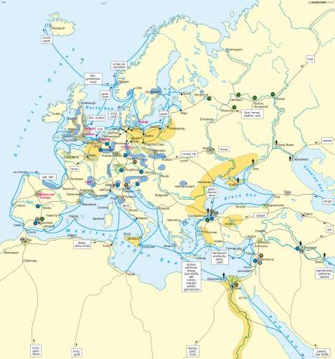
Figure 1: European Trade in the 1400s

Slide 4
The Geography of Europe’s Transition from Feudalism to Capitalism
What were the main geographical features of the transition (see Figure 2)?
A. City-state Europe (rise of merchant class, banks as intermediaries) (1400s-1530)
This happened in a belt running from central and northern Italy northwards to Flanders. This was the center of European merchant capitalism. Letters of credit based on prices established by merchants engaged in trade (market exchange) were key to this explosion of commerce and trade. The left-hand map in Figure 2 shows the main linkages in the first period. In the late 1400s this came under challenge with the Portuguese and Spanish conquests in the Americas. This was a spinoff from the Renaissance and increased learning about the earth from the writings of the ancient Greeks and Arab philosophers.
B. Discoveries/early colonialism/ Spain and Portugal – dissipating their gold and silver by military spending (1500-1600)
The upper-right hand map shows the next stage. The rulers of Spain and Portugal (after 1570) were intent on trying to turn their wealth in precious metals from Mexico and Peru into the base for making a Europe-wide empire combining their central European with their Iberian territories. They overspent and were increasingly challenged by the new territorial states of England, France and the Dutch Republic.

Slide 5
C. Mercantilism in NW Europe (England, France, Netherlands) (1550-1700)
(1) Balance of payments (2) bullion/privateering (3) state-licensed companies (East India Company, Dutch East India Company, Hudson’s Bay Company, etc.)
Compared to the more competitive merchant capitalism of Italy and Flanders before 1530, this version in NW Europe was much more government organized. There were state licensed private-public companies given trading monopolies in different parts of the world. Governments, particularly that of England before 1700, licensed pirates (as “privateers”) to steal gold and silver bullion on the high seas from foreign ships (mainly Spanish but also Arab and Mughal (Indian) ones). The logic was to accumulate capital nationally by minimizing imports/maximizing exports, storing precious metals (on which the value of money was directly based), and encouraging risky foreign ventures by individuals and firms by underwriting them publically (lower right-hand map in Figure 2)..

Slide 6
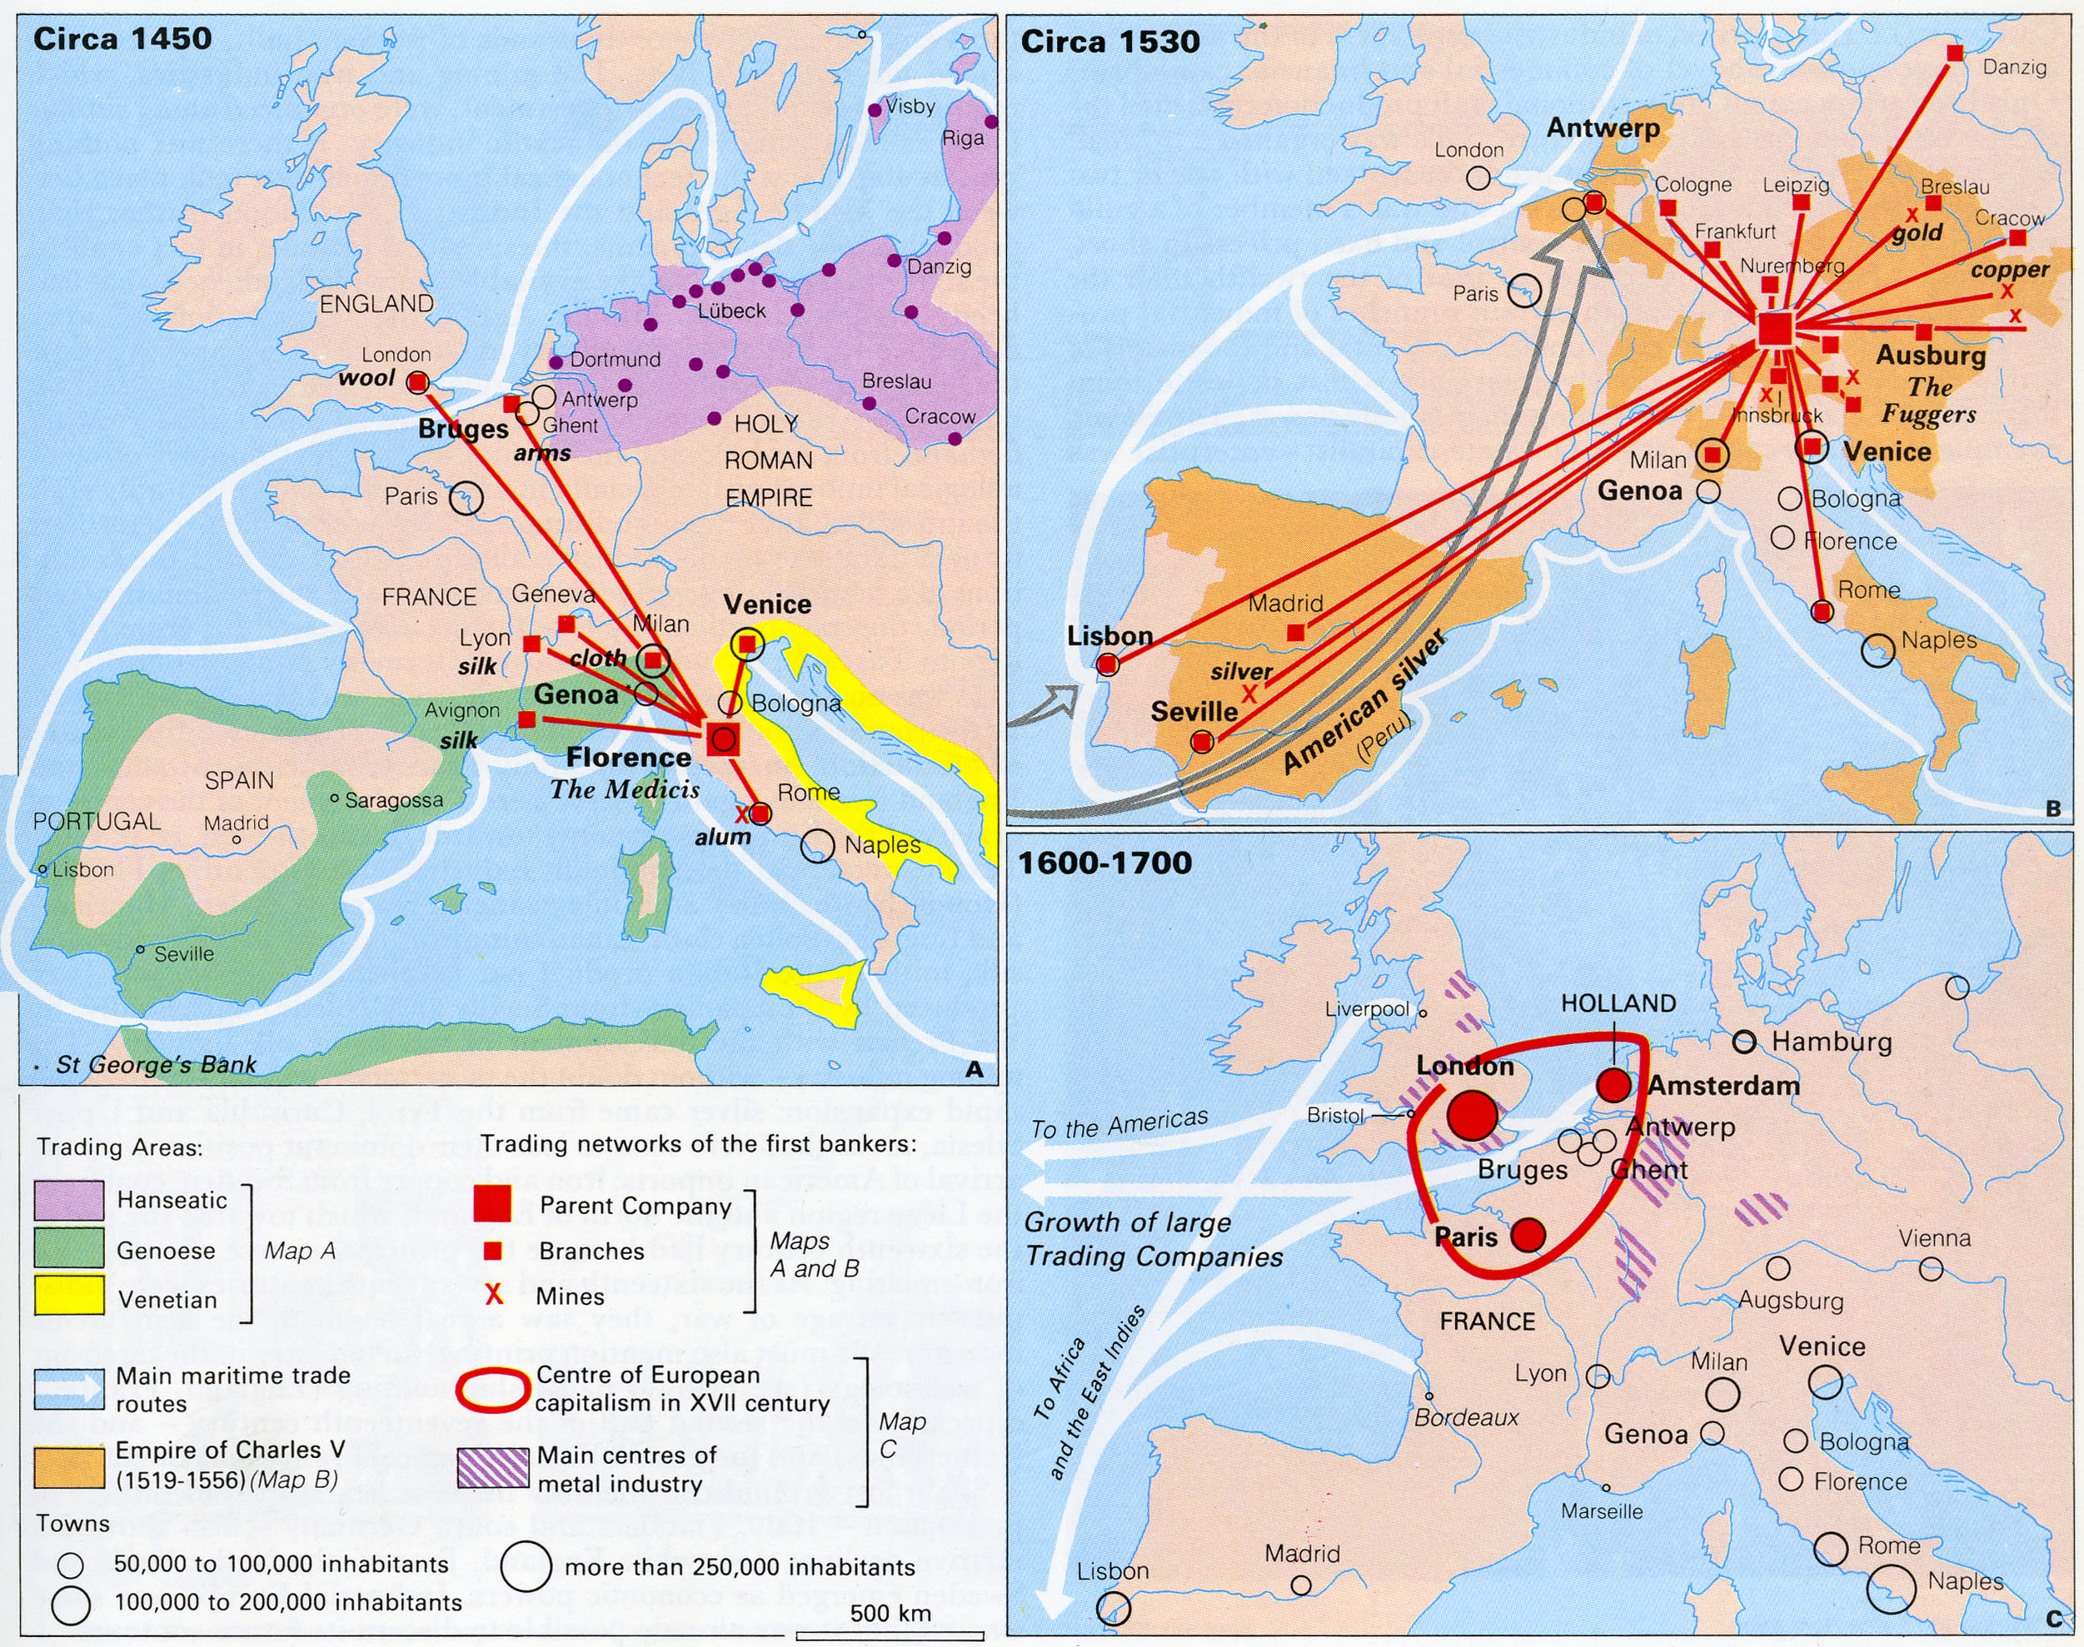
Figure 2: The Shift of Economic Gravity Within Europe, 1450-1700

Slide 7
Conclusions
Ascendance of market exchange in medieval Europe: fragmentation of political power plus rise of trade as feudalism disintegrated. No single empire established across Europe.
Challenged by redistributive impulses: first, from Spanish and Portuguese colonialism and Spanish efforts at creating a Europe-wide empire and, second, mercantilist systems in NW Europe based on trading but operating colonial empires.
None of these ever succeeded in creating empires within Europe. Merchant capitalism led to the centrality of capital accumulation as opposed to the control over land characteristic of feudalism. From now on this was to be the governing impulse in the world economy: a world that should know no boundaries in the search for profit.

